Slide 1



Full Stack Developer
Judul Mission : Mission 4
Disusun oleh : Efan Yacha R - 16026
Email : efanyacha@gmail.com
Restricted - For Student Only

Slide 2
Link GitHub :
https://github.com/efanyacha/Mission-4-Basic.git

Slide 3
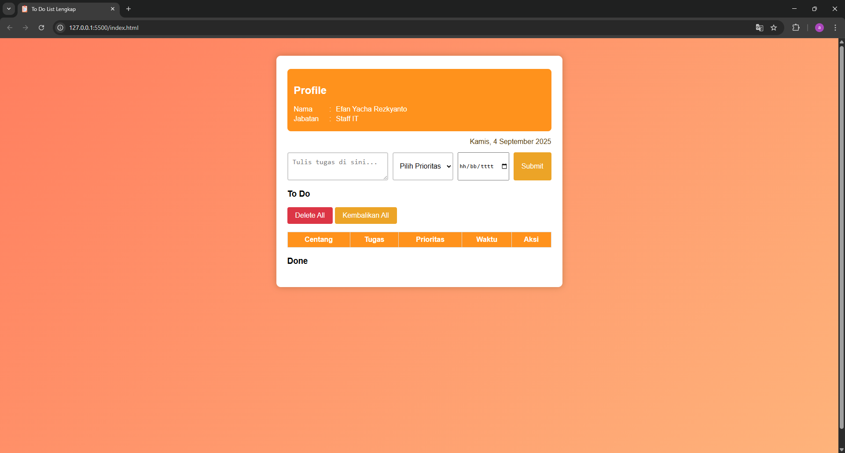
Page Awal

Slide 4
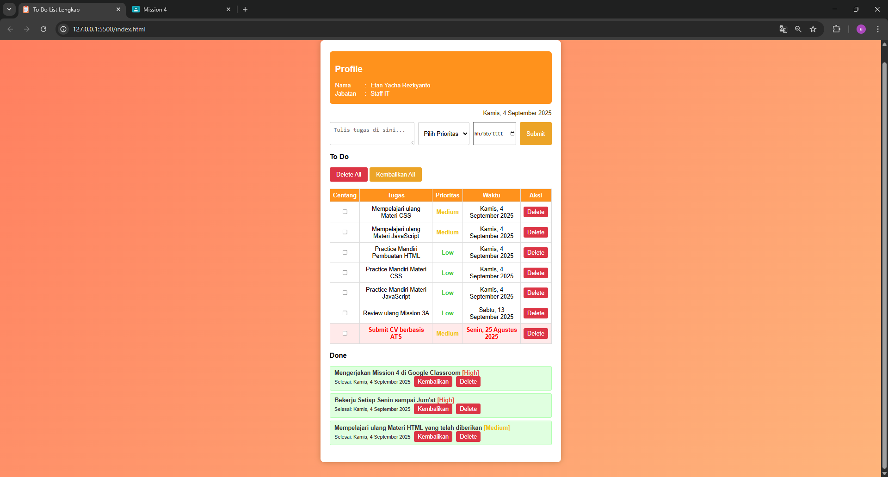
Page setalah mengisi To Do List

